Slide 1
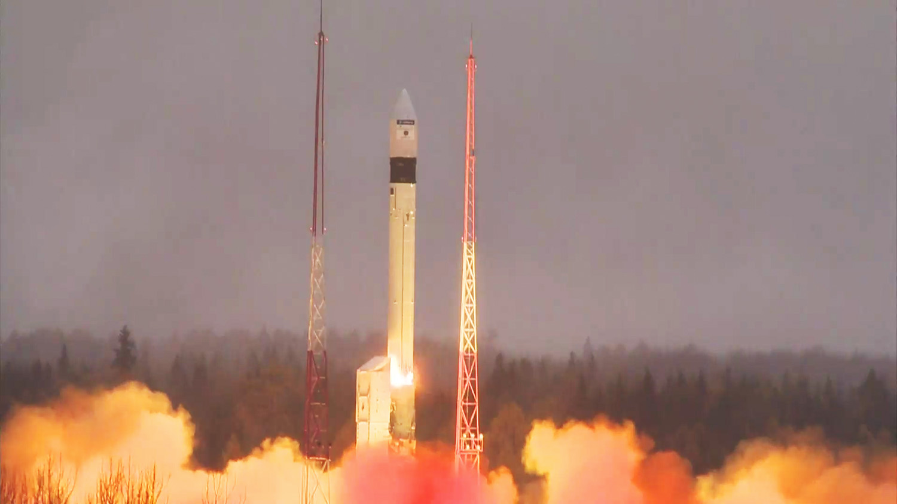
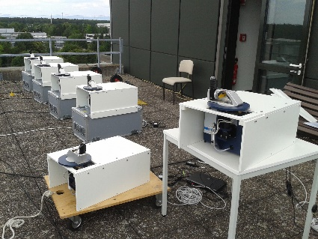
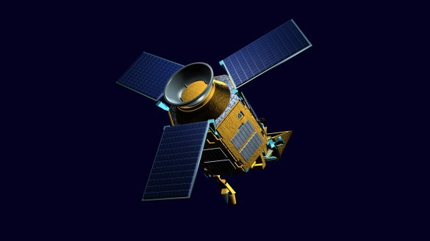
S5P CH₄ & CO validation
Mahesh Kumar Sha*, Bavo Langerock, Martine De Mazière, Darko Dubravica, Frank Hase, Carlos Alberti, Dimitrios Balis, Thomas Blumenstock, Matthias Frey, Pauli Heikkinen, Nicole Jacobs, Eugene Marais, Marios Mermigkas, Amelie Roehling, William Simpson, Qiansi Tu with contributions from the COCCON team, SRON team and S5P MPC-VDAF
* mahesh.sha@aeronomie.be

Slide 2
Sentinel-5 Precursor
Sentinel-5 Precursor (S-5P) is the first of the ESA atmospheric composition of Sentinels contributing to the European Commission Copernicus Programme to improve our understanding of the planet and the environment.
S5P – launched on 13th October 2017, near-polar sun-synchronous orbit at an altitude of 824 km with an ascending node equatorial crossing at 13:30, orbit cycle 16 days (14 orbits per day, 227 orbits per cycle). Mission duration 7 years.
TROPOsheric Monitoring Instrument (TROPOMI) is the single payload onboard S5P. It is a grating spectrometer covering 8 bands (UV – short-wave IR), and it uses a common telescope for UVN and SWIR. Pushbroom configuration and wide swath (108° → 2600 km on surface). The primary products measured are Ozone, NO₂, CO, CH₂O, CH₄, SO₂, Aerosol, Clouds and UV-Index. The application of the data measured will be on ozone layer monitoring, climate monitoring, air quality monitoring and forecast, volcanic plume detection, and UV index forecast.
CH₄ and CO products have a spatial sampling of 7x7 km². As of 6 August 2019 (orbit 9388) the along track resolution was increased from 7 km to 5.5 km.
Table 1 – Sentinel-5P TROPOMI mandatory atmospheric composition data products addressed in this talk
Parameter | Data Product | Vertical resolution | Systematic Uncertainty Requirement | Random Uncertainty Requirement
CH₄ | Total CH₄ | Total column | 1.5% | 1%
CO | Total CO | Total column | 15% | <10%

Slide 3
Ground-based network used for the validation study
Collaborative Carbon Column Observing Network
http://www.imk-asf.kit.edu/english/COCCON.php
Hosted by Karlsruhe Institute of Technology (KIT)
QC / QA and calibration of each unit by KIT, traceable to co-located TCCON and reference EM27/SUN
Usage of common analysis tools PREPROCESS (raw interferogram ➔ spectrum) + PROFFAST (spectrum ➔ Xgas)
Individual processing by site PIs or possibility to use central processing and data dissemination facility at KIT supported by ESA
GEOMS template for COCCON has been defined and currently being implemented and tested at the COCCON central facility at KIT
BIRA supports data QA/QC of the data stream from the CF to the final EVDC data repository and performs / coordinates satellite validation activities.
Supplement TCCON with portable units
Denser sampling for observing GHG gradients on smaller scale
Traveling standard – stable calibration characteristics, linking high resolution measurements on continental scale
Suitable for satellite validation

Slide 4
Coincidence criteria used for the validation study
Period of study started with the first available data (17 November 2017) till 1 January 2021
COCCON data from 6 stations used in this study ➔ Many Thanks! (Data from 6 other stations submitted recently)
S5P data from the Copernicus data hub and the Mission Performance Centre (MPC) provided by the Payload Data Ground Segment (PDGS) at DLR
S5P CH₄ and CO versions RPRO & OFFL – latest version of the files taken for the validation
Coincidence criteria for CH₄ and CO: Time delta = 1h (similar to TCCON validation results)
Geo-distance delta (radius) = 100 km (for CH₄), and 50 km (for CO) (similar to TCCON validation results); qa_value>0.5.
From the coincident and filtered satellite measurements an average of all pixels was taken for each COCCON measurement
S5P CH₄ and CO priori is used as common prior (Rodgers, 2003), altitude correction is done for each satellite pixel to the ground-based station height
Validation using TCCON & NDACC CH₄ and CO data are part of the ESA MPC-VDAF study (https://mpc-vdaf.tropomi.eu/) and SVANTE (S5P Validation and Calibration Experiment, https://s5pcampaigns.aeronomie.be/) project

Slide 5
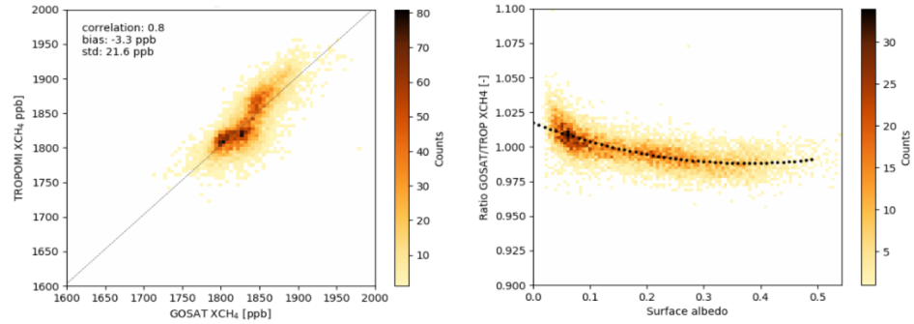
S5P XCH₄ products
Official methane level 2 files contain two types of methane data: (1) standard XCH₄ product and (2) bias corrected XCH₄ product
The standard XCH₄ product shows a surface albedo dependence which is corrected using GOSAT XCH₄ data
Reference: ATBD for Sentinel-5 Precursor Methane Retrieval

Slide 6
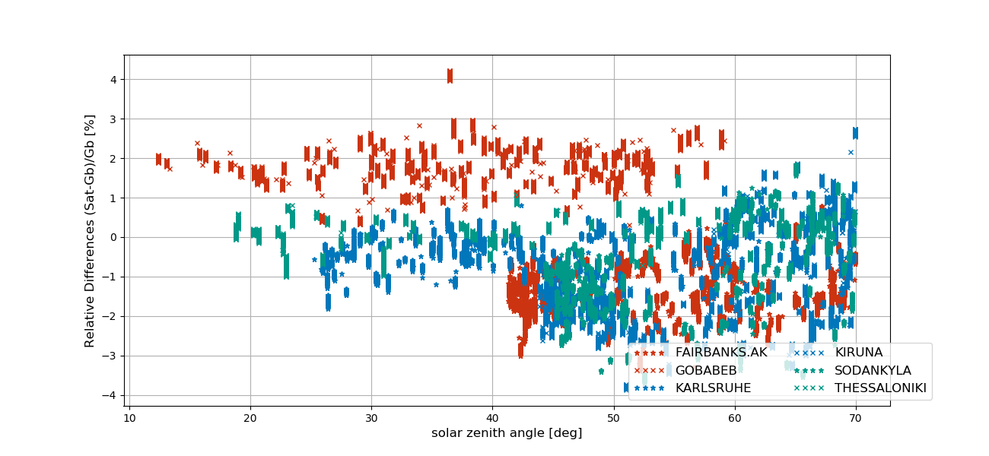
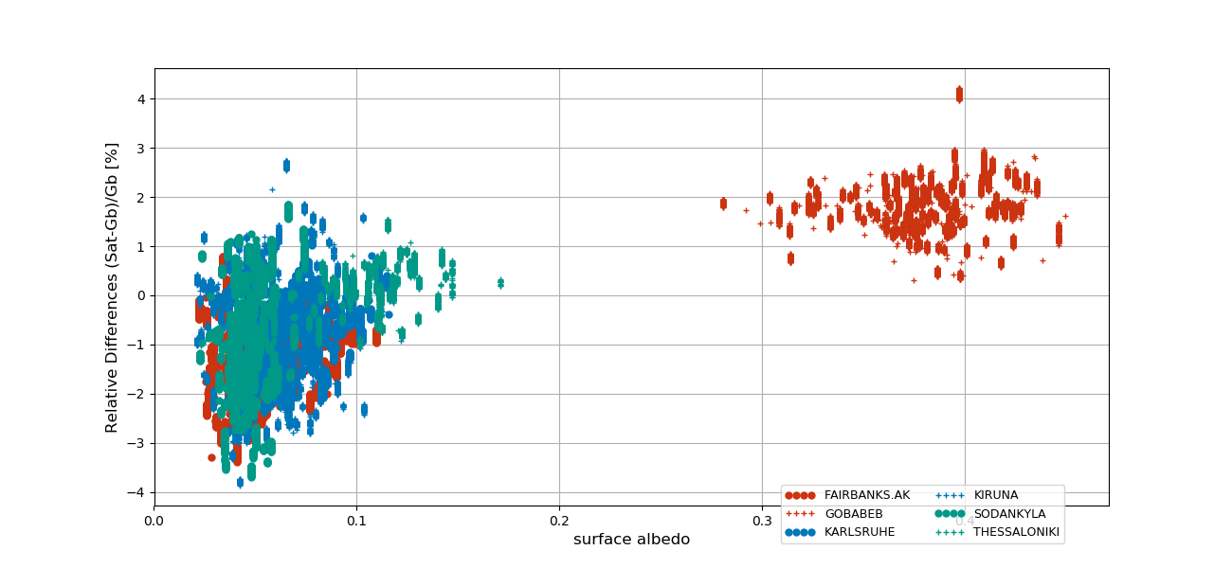
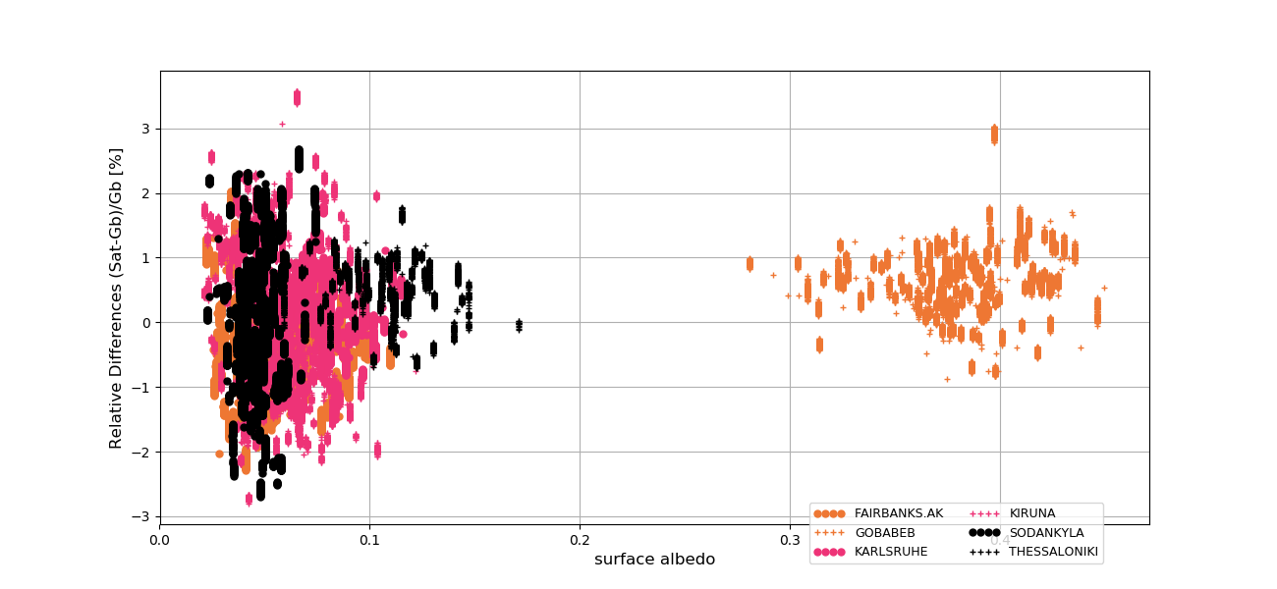
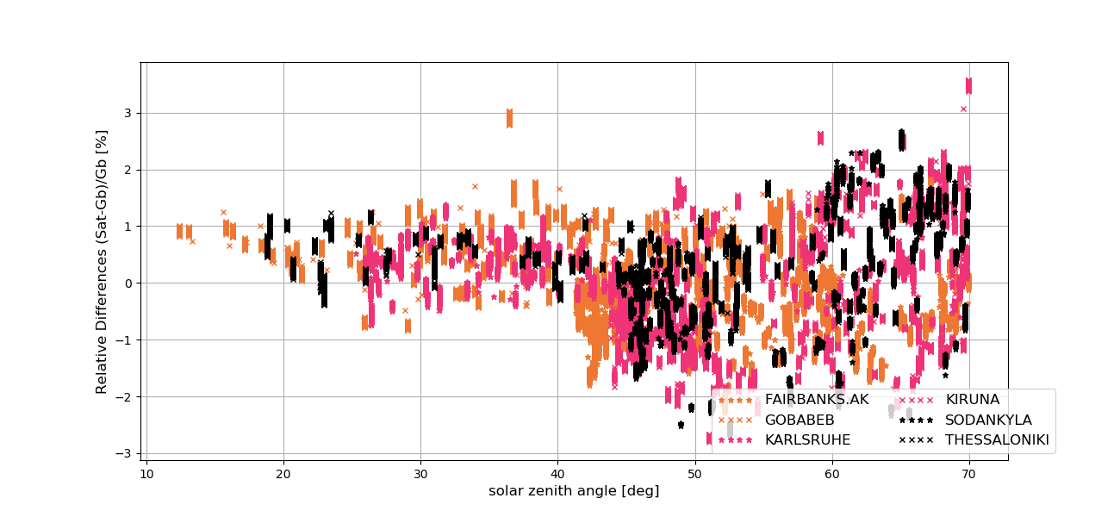
S5P validation results – XCH₄
S5P standard XCH₄ product
S5P bias corrected XCH₄ product
Bias dependence seen for high SZA
High scatter remains for very low surface albedo

Slide 7
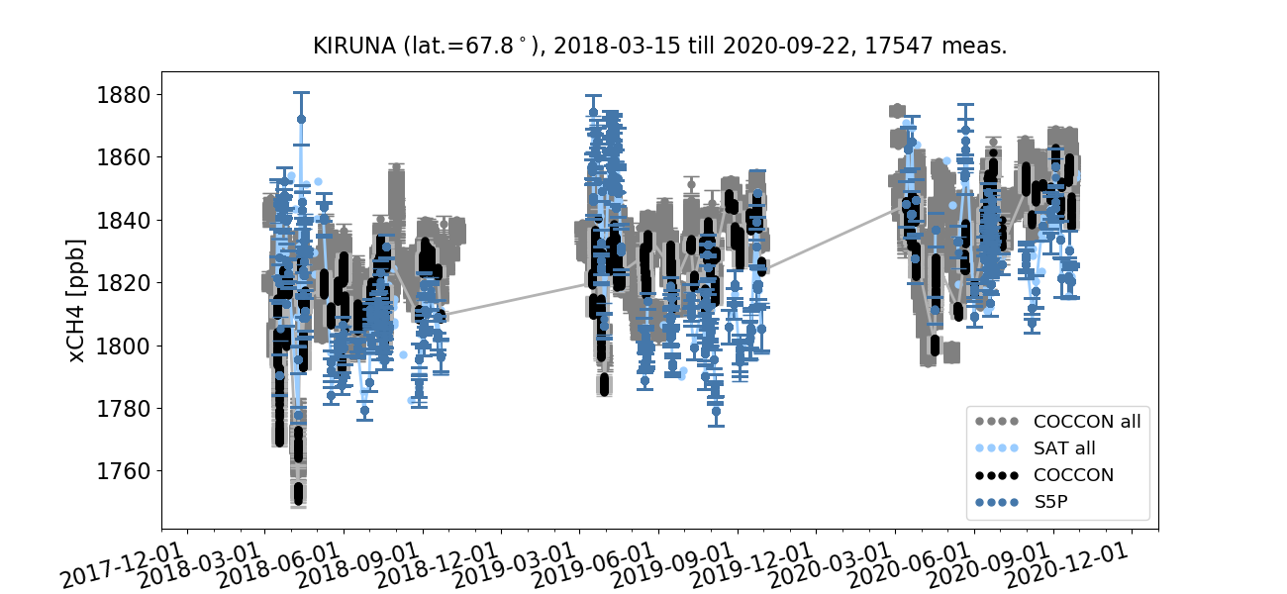
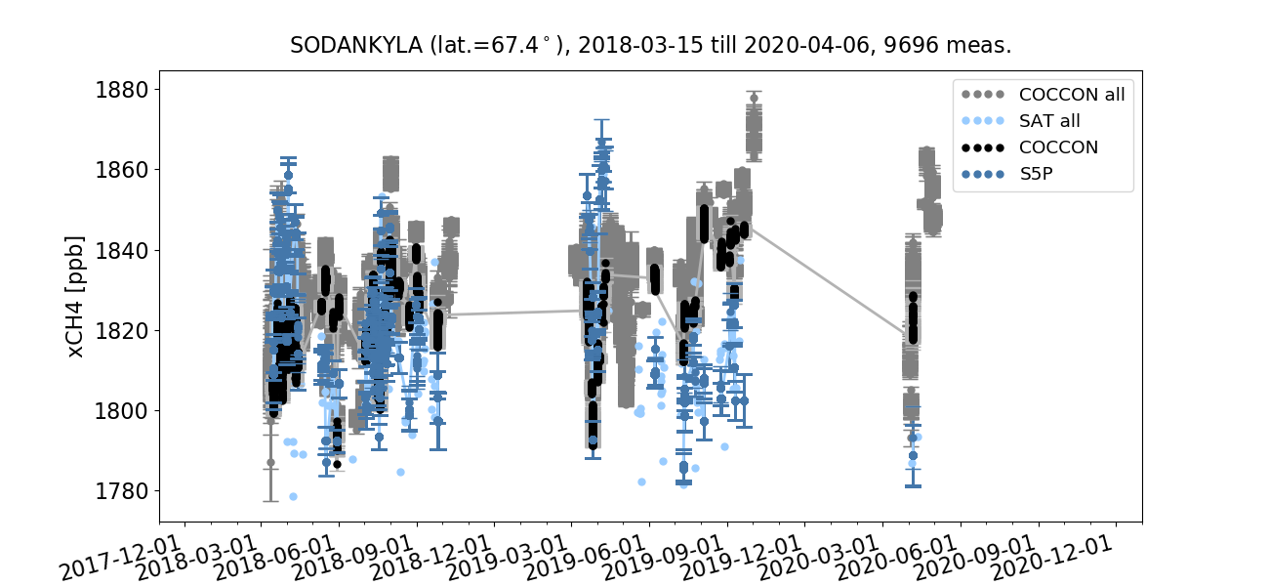
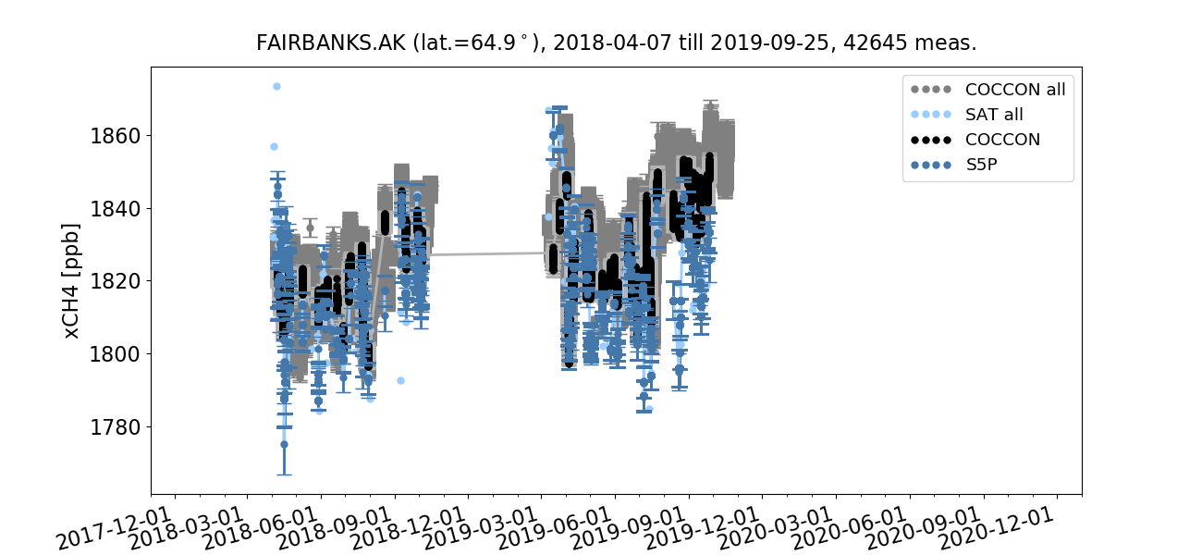
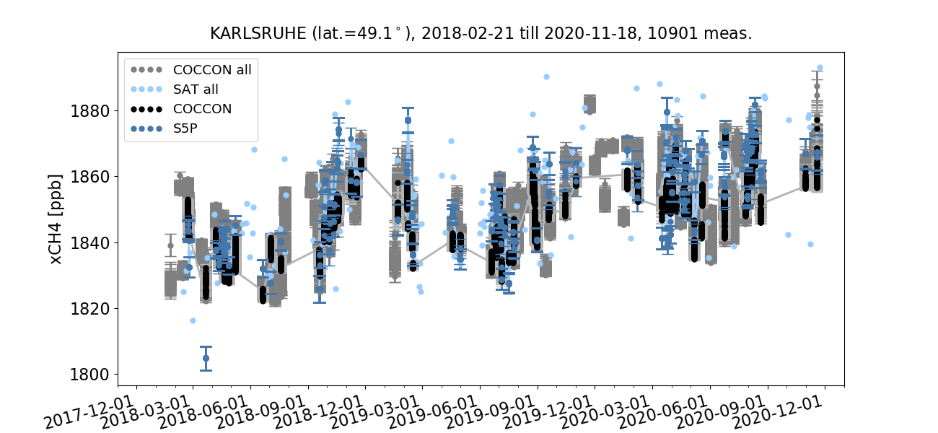
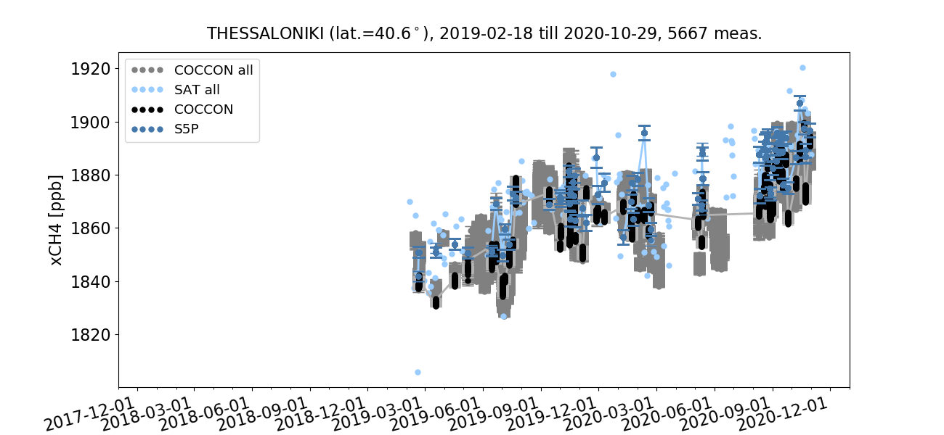
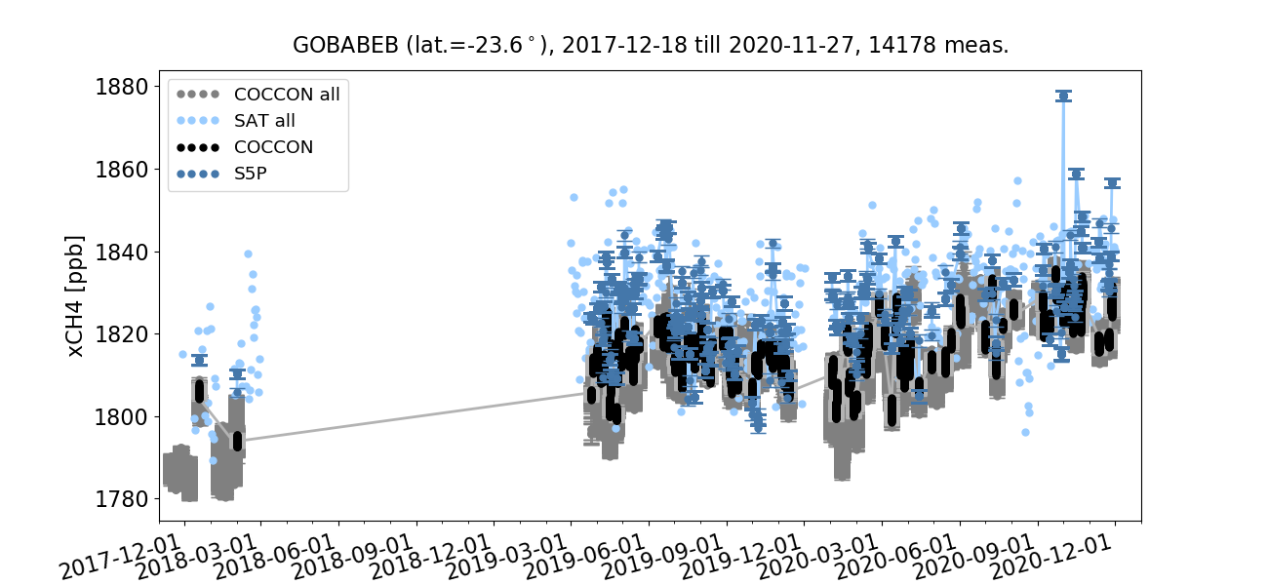
S5P validation results – XCH₄

Slide 8
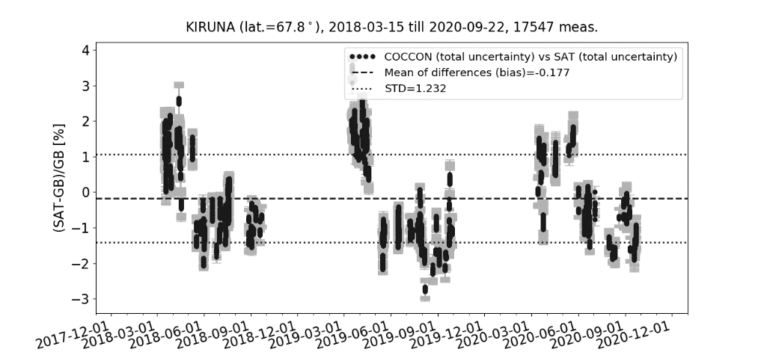
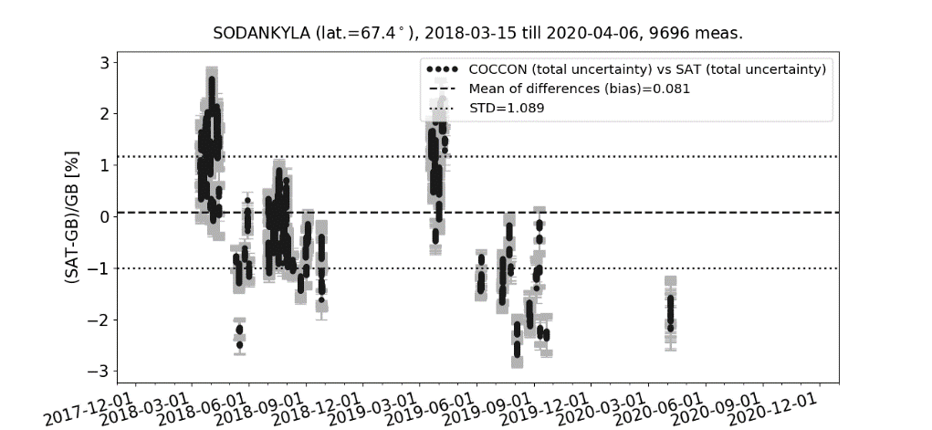
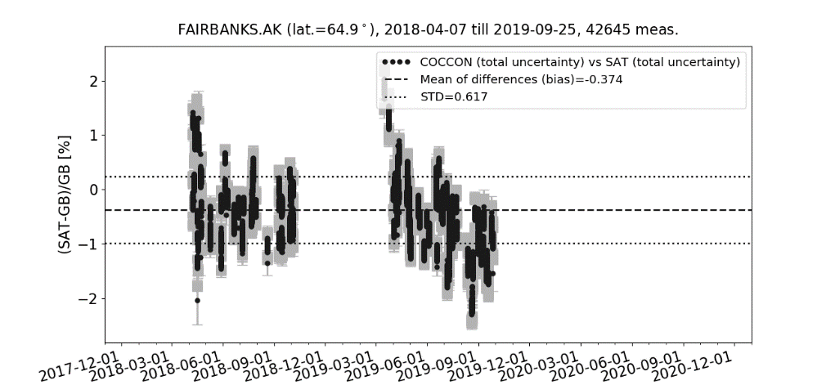
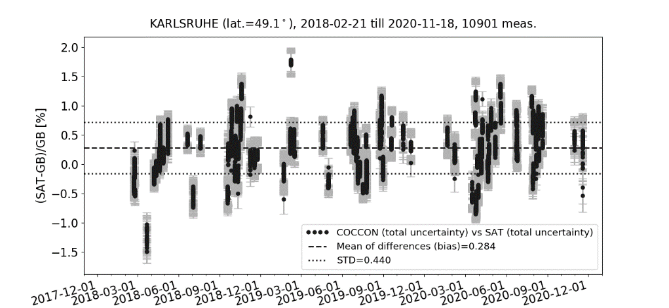
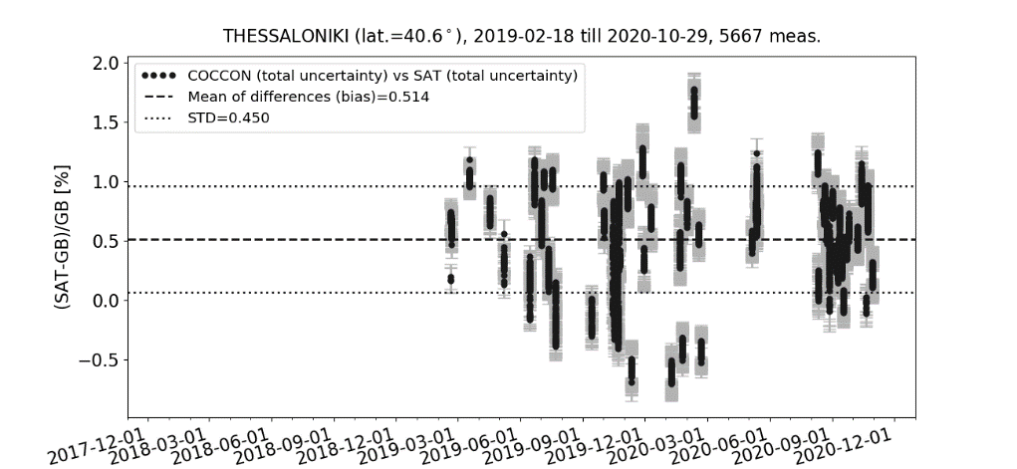
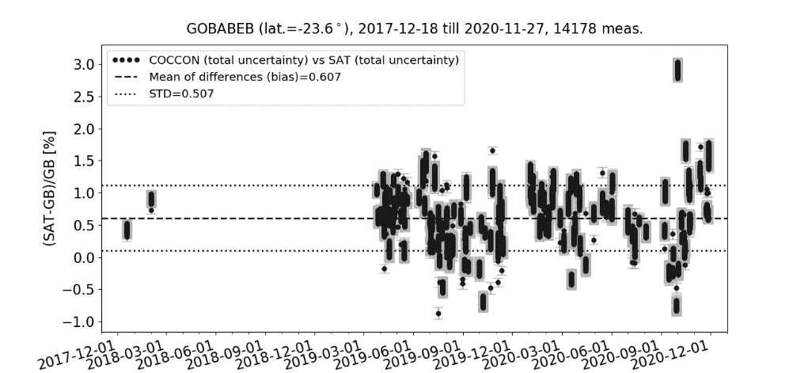
S5P validation results – XCH₄

Slide 9
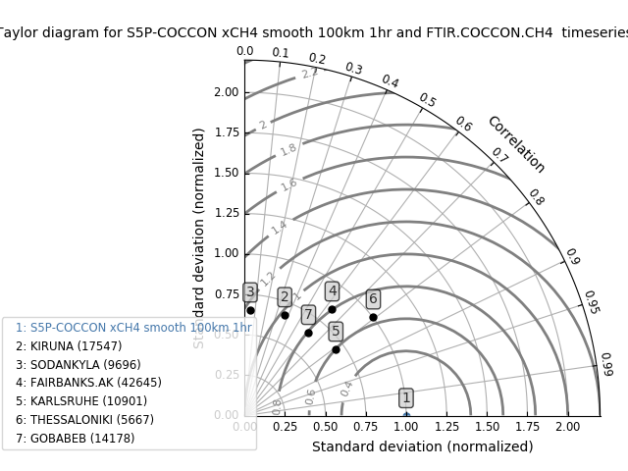
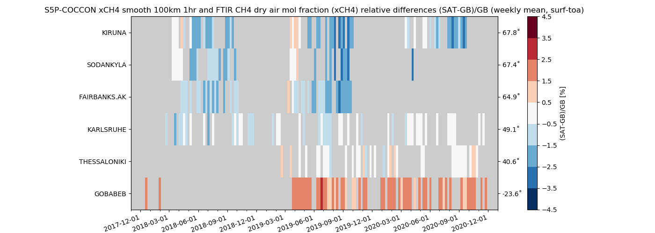
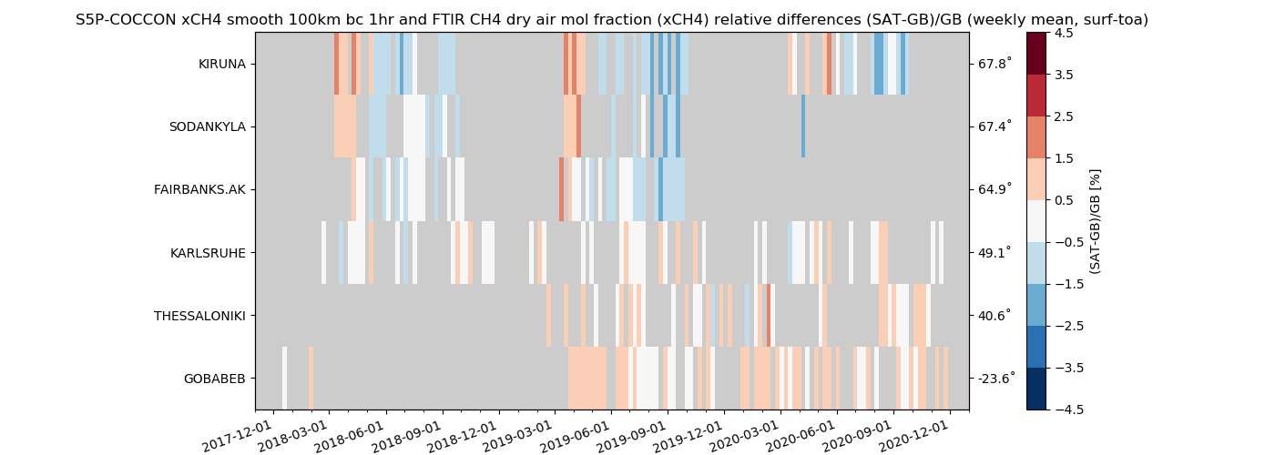
S5P validation results – XCH₄
Standard XCH₄
Bias corrected XCH₄

Slide 10
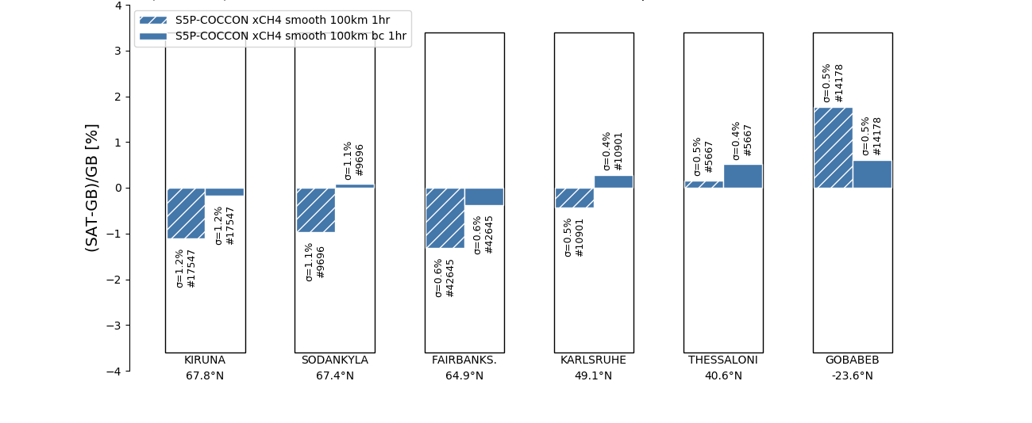
S5P validation results – XCH₄
relbias mean (%) relbias std(%)
Dashed blue: Standard XCH₄ -0.32 0.73
Solid blue: Bias corrected XCH₄ 0.16 0.72
S5P requirements XCH₄ 1.5 1
High albedo site

Slide 11
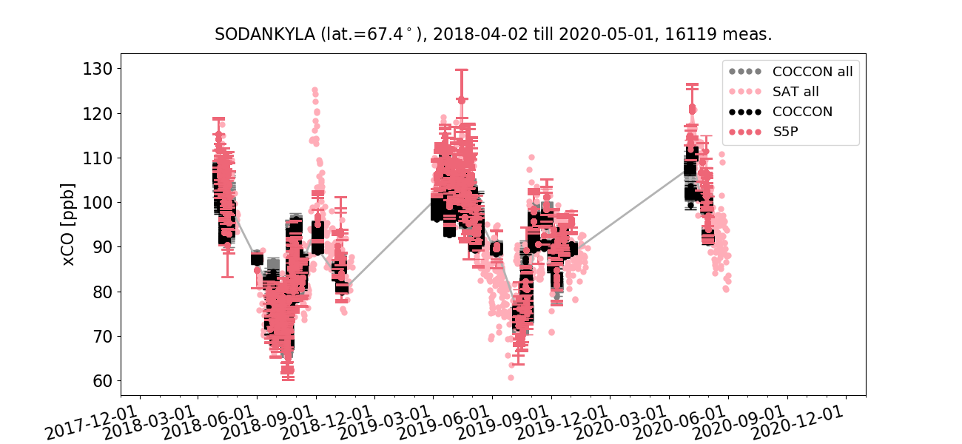
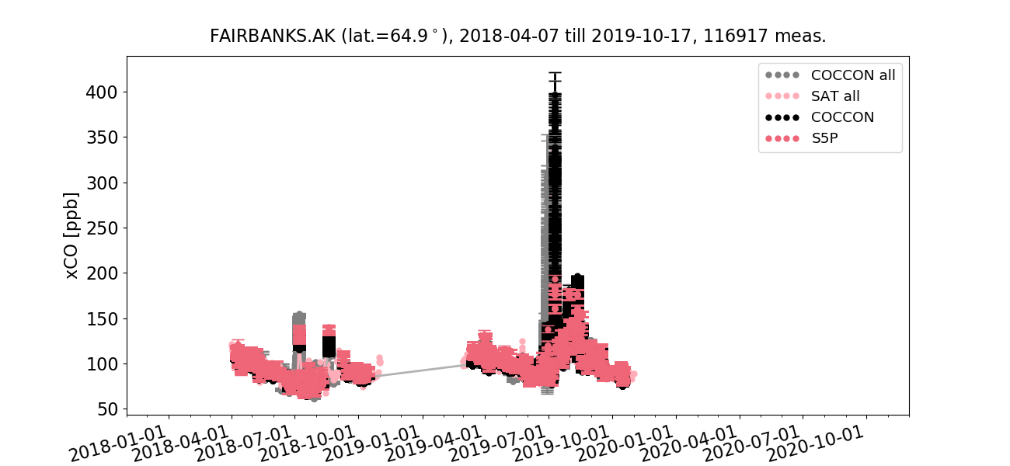
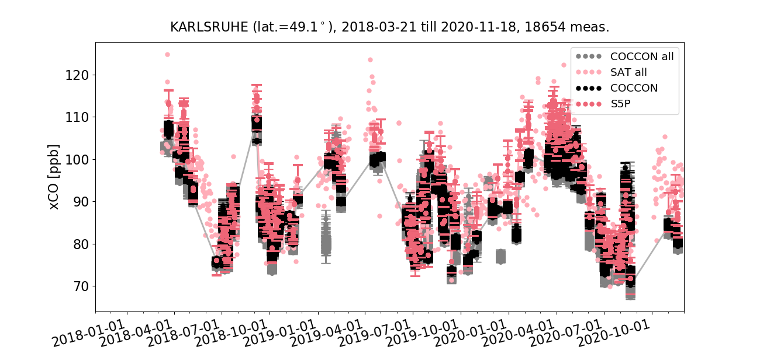
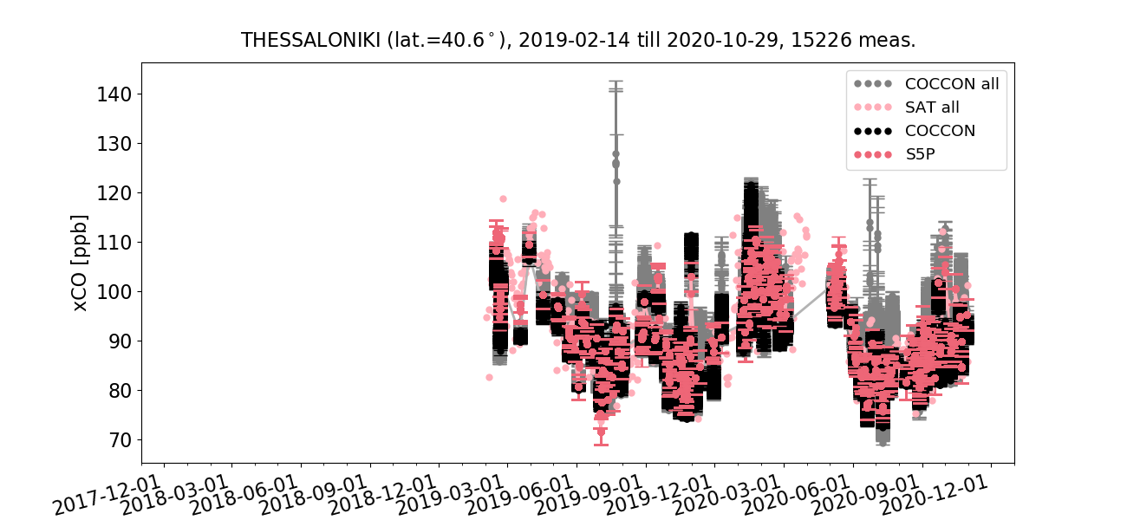
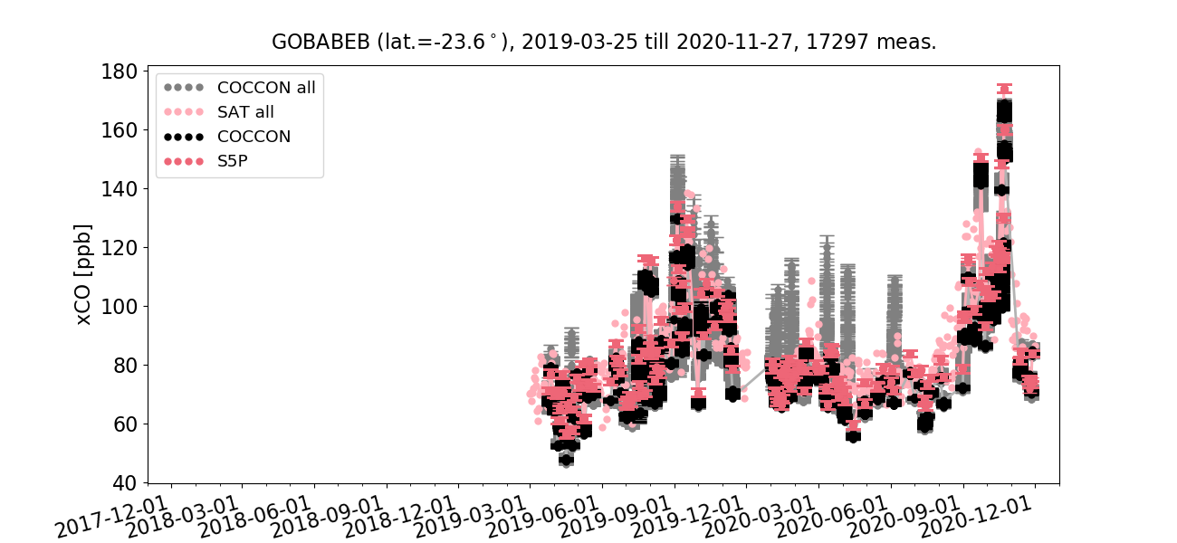
S5P validation results – XCO

Slide 12
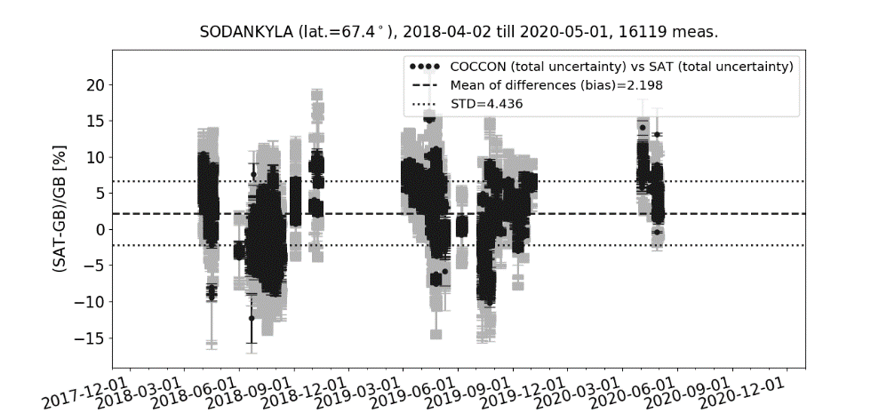
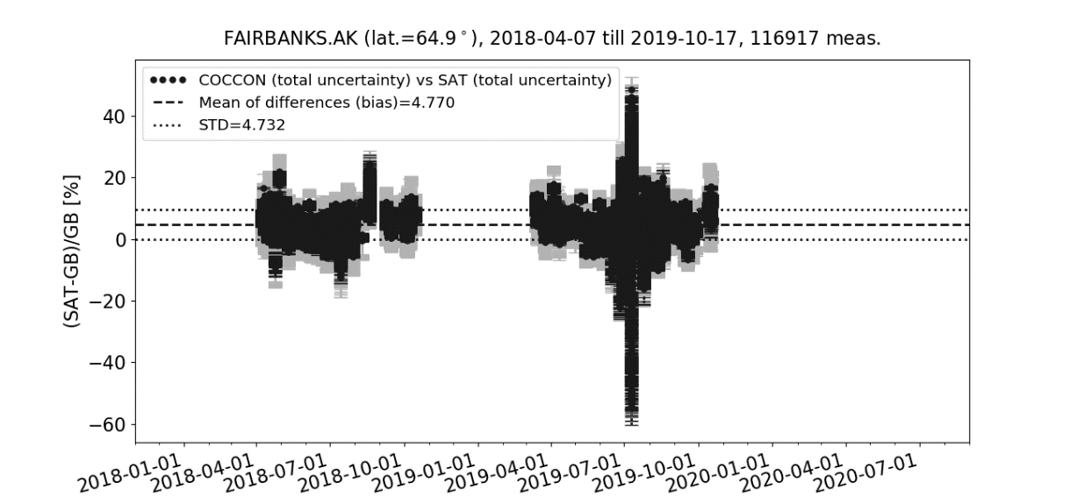
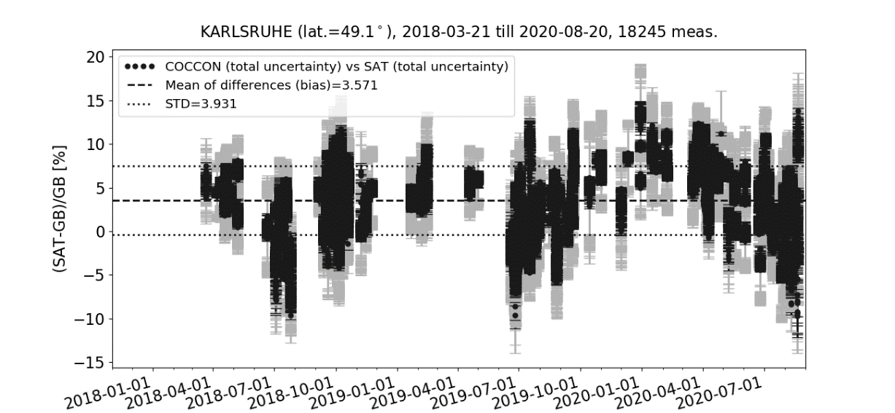
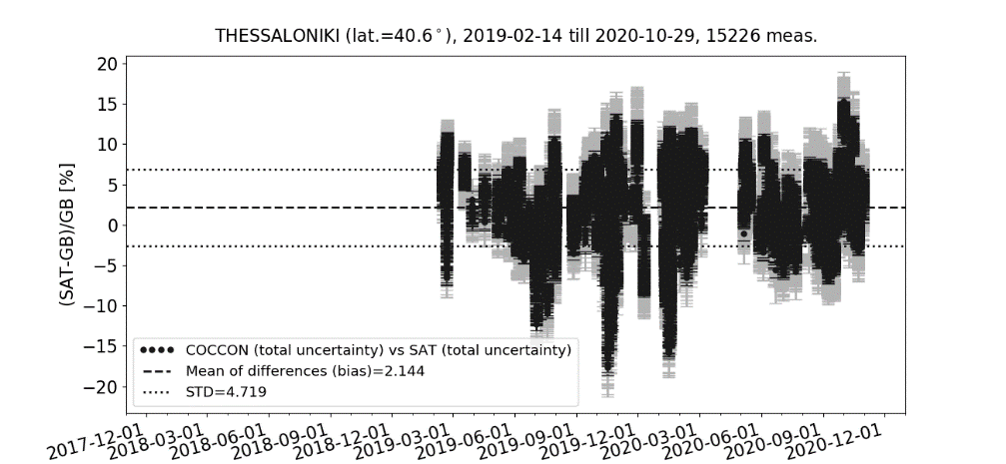
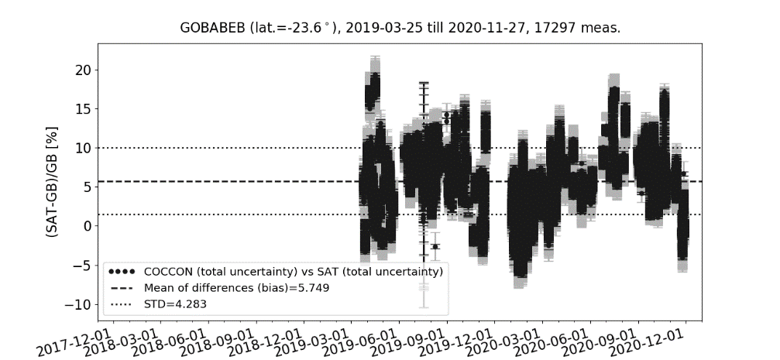
S5P validation results – XCO

Slide 13
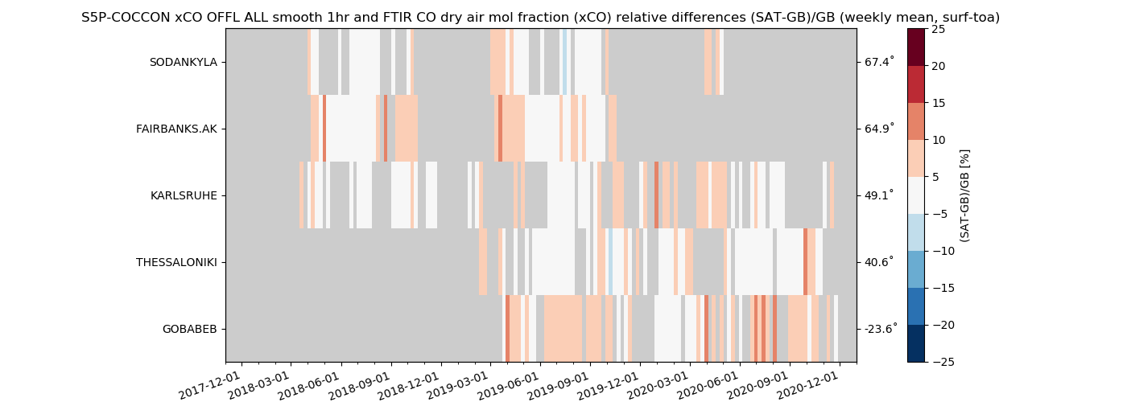
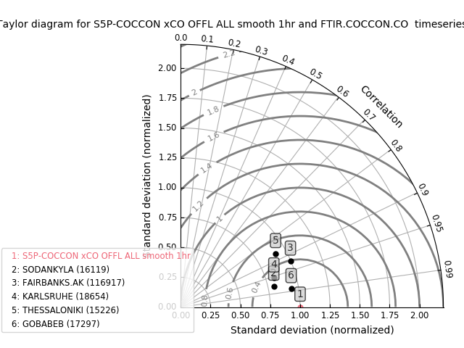
S5P validation results – XCO

Slide 14
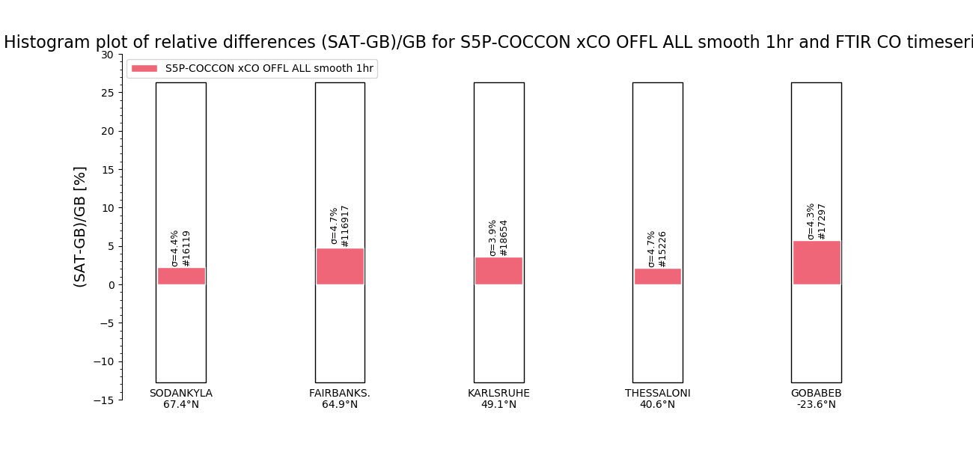
S5P validation results – XCO
relbias mean (%) relbias std(%)
Solid red: S5P XCO 3.70 4.42
S5P requirements XCO 15 <10

Slide 15
Information
ESA project supporting S5P validation work using COCCON network data is currently running. EM27/SUN operators are most welcome to send their data to be included in the MPC validation work.
A paper focusing on the validation of satellite data products (S5P & OCO-2) using global COCCON network data is planned. If you want to participate in the paper please send me an email.
Thank you for your attention!
Questions / comments to mahesh.sha@aeronomie.be

